Slide 1
Heart Disease Diagnostic-Analysis
Detailed Project
Sikha Pandey

Slide 2
Project Deatil
Project Title | Heart Disease Diagnostic Analysis
Technology | Business Intelligence
Domain | Health Care
Project Difficulty Level | Advanced
Programming Language Uses | Python
Tools Used | Kaggle, Power BI, Excel

Slide 3
Objective:
The goal of this project is to analyze heart disease occurrence based on a combination of features that describe heart disease.

Slide 4
Problem Statement:
As the rate of Heart Disease is increasing rapidly and also in the pandemic we all realized the effect of covid-19 on all. We need to analyze health data for better future preparation. Taking a dataset that includes some of the information of some people.

Slide 5
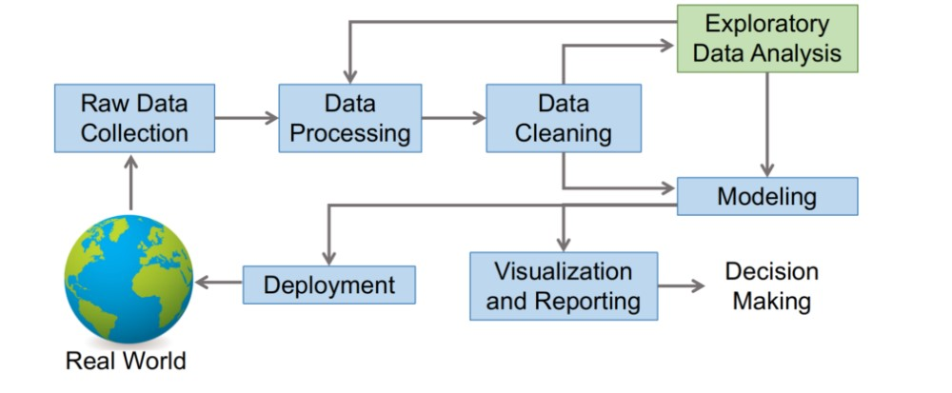
Architecture

Slide 6
Dataset Information :
age: Age of the person
sex: Person's sex(1 = male, 0= female)
cp: Chest Pain. There are four types of pain chest pain(Angina).(1:Typical Angina, 2: Atypical Angina, 3: Non-anginal pain, 4: Asymptomatic)
tresttbps: resting blood pressure in mm Hg on admission to the hospital.
chol: Person's cholesterol level.
fbs: Person's fasting blood sugar level(1= True, 0= False)
restecg: Resting electrocardiogram.
thalach: It is a continuous data type that describes the max heart rate achieved.
exang: Exercise-induced angina(1= yes, 0 = No)
oldpeak: ST depression induced by exercise relative to rest.
Slope: The slope of the peak exercise ST segment(1: upsloping, 2: flat, 3: downsloping)
ca: number of major vessels (0-3) colored by fluoroscopy (for calcification of vessels).
thal: results of nuclear stress test (3 = normal; 6 = fixed defect; 7 = reversible defect).
num : target variable representing diagnosis of heart disease (angiographic disease
status) in any major vessel(0 = no, 1 = yes).

Slide 7
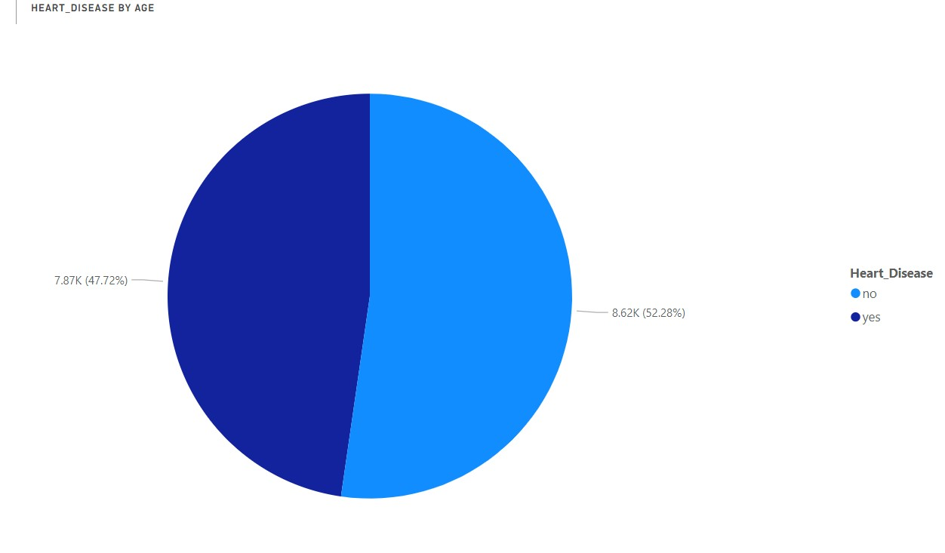
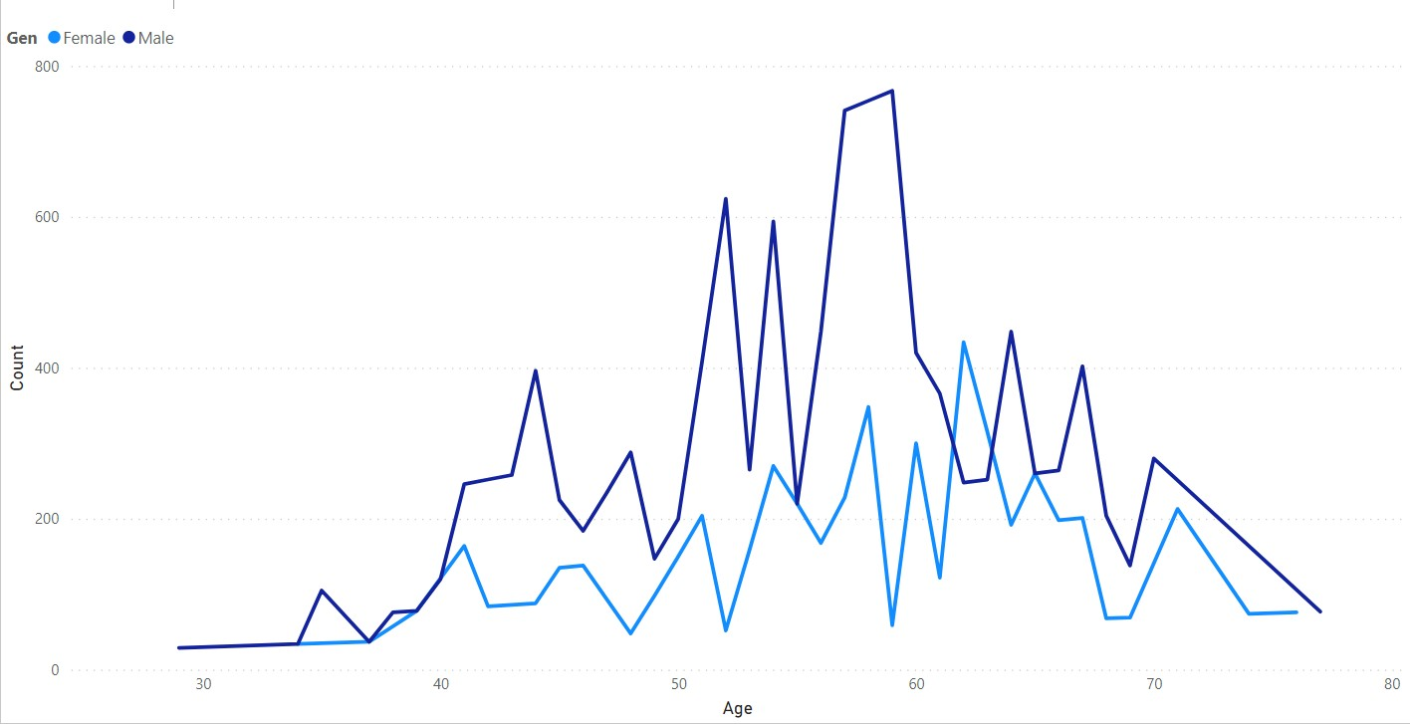
What Kind of population do we have :
According to the distribution, 47.72% of people are suffering from Heart Disease
Elderly males and females are more likely to suffer from heart disease. Males are between 50 to 60 years and Females are between 55 to 65 years.

Slide 8
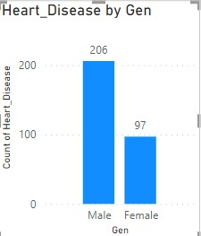
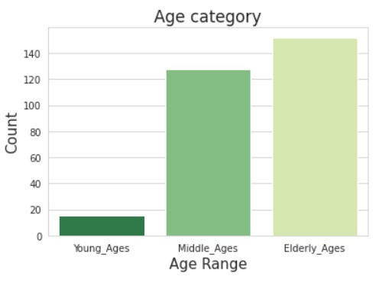
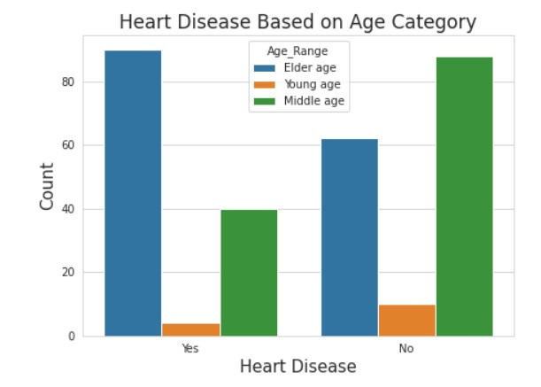
Who Suffers from Heart Disease:
Males are more prone to heart disease.
Elderly people suffer more from heart disease.

Slide 9
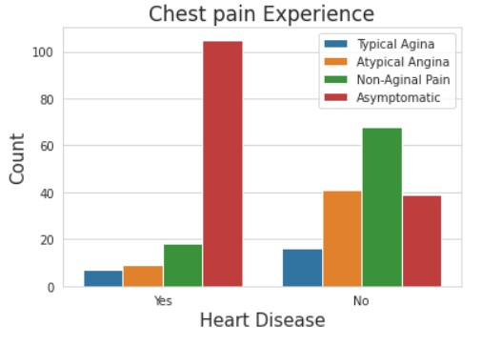
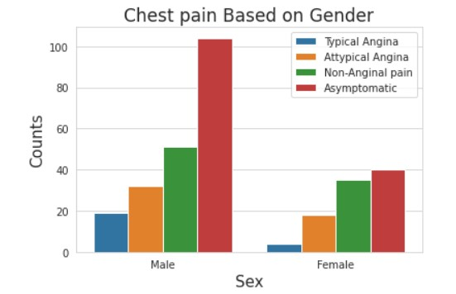
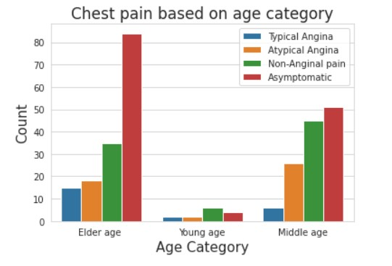
People having Asympyomtic chest pain have a higher chance of heart disease.
Chest Pain Experienced by People

Slide 10
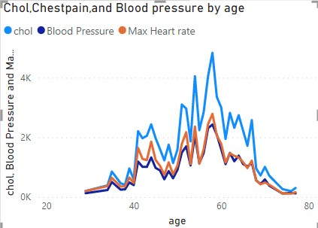
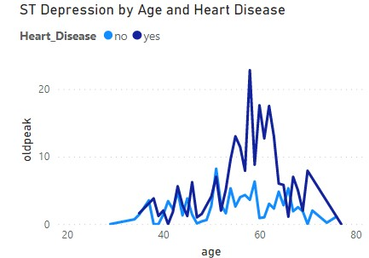
Other symptoms experienced in Heart Disease
Blood Pressure increases between the age of 50-60 and continues till 70.
Similarly Cholesterol level and max heart rate increase in between 50-60 age group.
The ST Depression also increases between the age of 50-65.

Slide 11
Key Performance Indicator (KPI)
Percentage of people having heart disease.
Heart disease based on gender.
Chest pain experienced by people suffering from heart disease.
Blood pressure, Cholesterol level, and maximum heart rate of people according to their age and heart disease patients.
ST Depression is experienced by people according to their age and heart disease.

Slide 12
Conclusion
47.74% of people are suffering from Heart Disease.
Elderly Ages Men are more (50 to 60 years) and Females are more (55 to 65) years category.
Males are more prone to Heart Disease.
Elderly Aged people are more prone to Heart Disease.
People having asymptomatic chest pain have a higher chance of Heart Disease.
Blood Pressure increases between age of 50 to 60 and continues till 70.
Cholesterol and Maximum heart rate increasing in the age group of 50-60.
ST Depression mostly increases between the age group of 50 -60.

Slide 13
Q&A
Q 1) What is the source of the data?
Ans- The dataset was taken from iNeuron.ai provided project description document.
https://drive.google.com/drive/folders/165Pjmfb9W9PGy0rZjHEA22LW0Lt3Y-Q8?usp=sharing
Q2) What was the type of data?
Ans- The data was both a combination of numerical and categorical data.
Q3) What Technique are used are used for data?
Ans- Removing unwanted attributes
- Removing outliers
- Cleaning data and checking null values.
- Converting Numerical data into categorical data.
- Visualizing relation of independent variables and with each other output variables.
Q4) what were the libraries used in python?
Ans- Pandas, Numpy, matplotlib, and Seaborn

Slide 14
Thank You

